Slide 1

Introducing Power BI
David is the manager of budgeting at Contoso, a company that sells electronic products worldwide through several retail shops and a website. Around the globe, country/region managers are responsible for producing figures for next year’s budget for their respective countries/regions, which David then aggregates to produce the big picture to show to his boss.
Our scenario begins in October 2015, when David commences working on the budget for 2016. As always, David has a Microsoft Excel workbook containing the relevant information to produce the budget. Based on the results of the workbook, he would typically create a Microsoft PowerPoint presentation to share the results during internal meetings. This year, however, David wants to take advantage of the new Power BI service provided by Microsoft.

Slide 2
Getting started with Power BI
Any journey begins with the first step, so let’s take that step together. David obtained from IT an Excel report that contains the sales for the past three years, divided by country/region, brand, and month.
Sales in Contoso are strongly brand-oriented, and some brands are prone to seasonal effects that David wants to take into account. For this reason, he uses data grouped by month.
Figure 1-1 shows a small portion of the resulting data, which he stores in an Excel file. If you would like to become more familiar with David’s data, you can open 2015 Sales.xlsx from the book’s companion content.

Slide 3
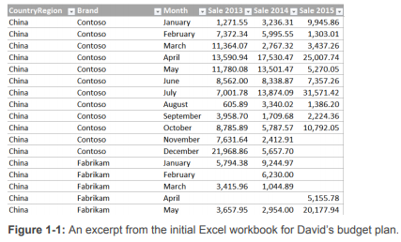

Slide 4
Every year, David makes some considerations on these numbers and then he shares his findings with the country/region managers, who then send back to him workbooks with their numbers for the next year.
Figure 1-1 shows some data from China, but there are several other countries/regions, as well. During the process of computing those numbers, there are many meetings and discussions in which the managers bring their experience and knowledge to bear on the process, adding their own versions of the original workbooks, each displaying various charts and calculations, which must all be explained to others.
This is a daunting task, to be certain, and one that David would like to streamline.

Slide 5
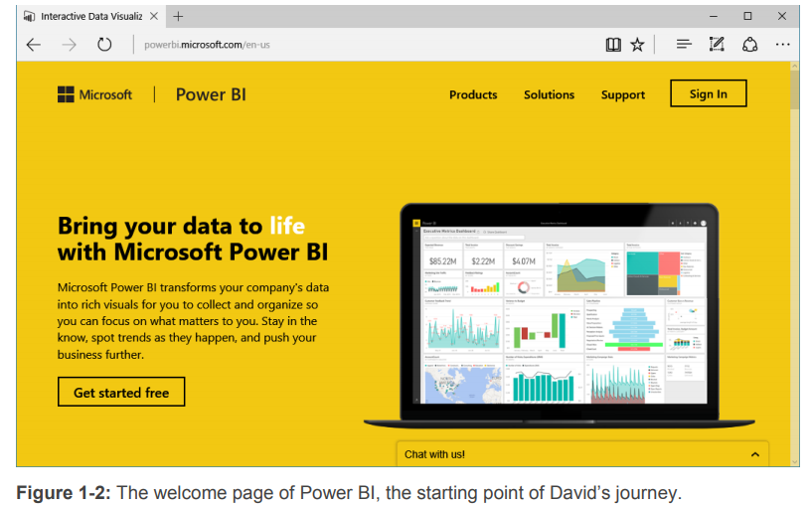
Fortunately, David heard about an interesting tool called Power BI that Microsoft created in 2015 that might be helpful toward creating a collaborative environment in which any stakeholder of the budgeting process can share his findings with others, working together on the goal. But, at this point, the name and maybe a marketing video is all that David knows about Power BI.

Slide 6
What is Power BI (Business Intelligence)?
Power BI is a Data Visualization and Business Intelligence tool that converts data from different data sources to interactive dashboards and BI reports.
Power BI suite provides multiple software, connector, and services –
Power BI desktop
Power BI service based on Saas (Cloud)
Power BI mobile apps
These set of services are used by business users to consume data and build BI reports.

Slide 7
Power BI - Components
Power Query: Data mash up and transformation tool.
Power Pivot: Tabular data modeling tool
Power View: Data visualization tool
Power Map: Visualizing Geo-spatial information in 3D mode
Power Q&A: Natural language question and answering engine.

Slide 8
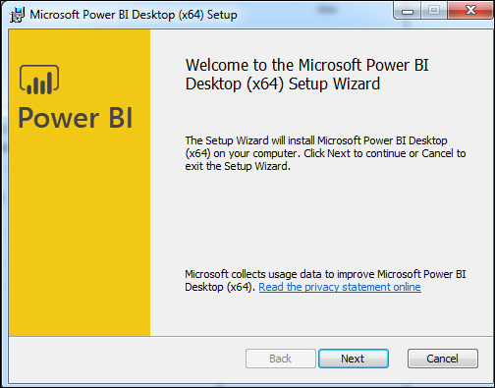
Power BI - Installation Steps

Slide 9
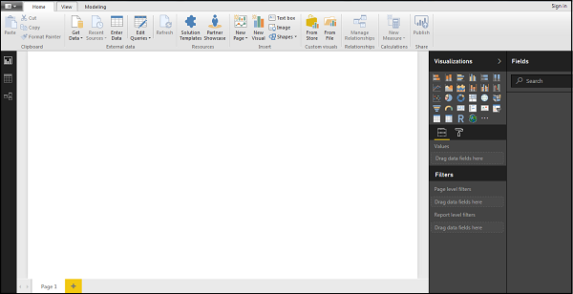
Power BI Desktop - Welcome Screen

Slide 10
Power BI – Architecture
Power BI includes the following components −
Power BI Desktop − This is used to create reports and data visualizations on the dataset.
Power BI Gateway − You can use Power BI on-premises gateway to keep your data fresh by connecting to your on-premises data sources without the need to move the data. It allows you to query large datasets and benefit from the existing investments.
Power BI Mobile Apps − Using Power BI mobile apps, you can stay connected to their data from anywhere. Power BI apps are available for Windows, iOS, and Android platform.
Power BI Service − This is a cloud service and is used to publish Power BI reports and data visualizations.

Slide 11
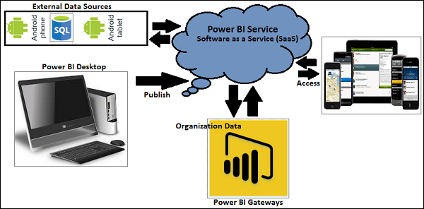

Slide 12
Power BI - Supported Data Sources
Power BI supports large range of data sources. You can click Get data and it shows you all the available data connections. It allows you to connect to different flat files, SQL database, and Azure cloud or even web platforms such as Facebook, Google Analytics, and Salesforce objects. It also includes ODBC connection to connect to other ODBC data sources, which are not listed.
Following are the available data sources in Power BI −
Flat Files
SQL Database
Online Services
Other data sources such as Hadoop, Exchange, or Active Directory

Slide 13
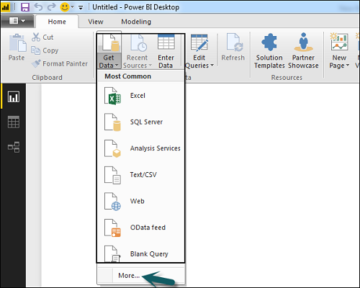
To get data in Power BI desktop, you need to click the Get data option in the main screen. It shows you the most common data sources first. Then, click the More option to see a full list of available data sources.

